Slide 1
Pure Data Synthesizer
Jeffrey Lansford

Slide 2
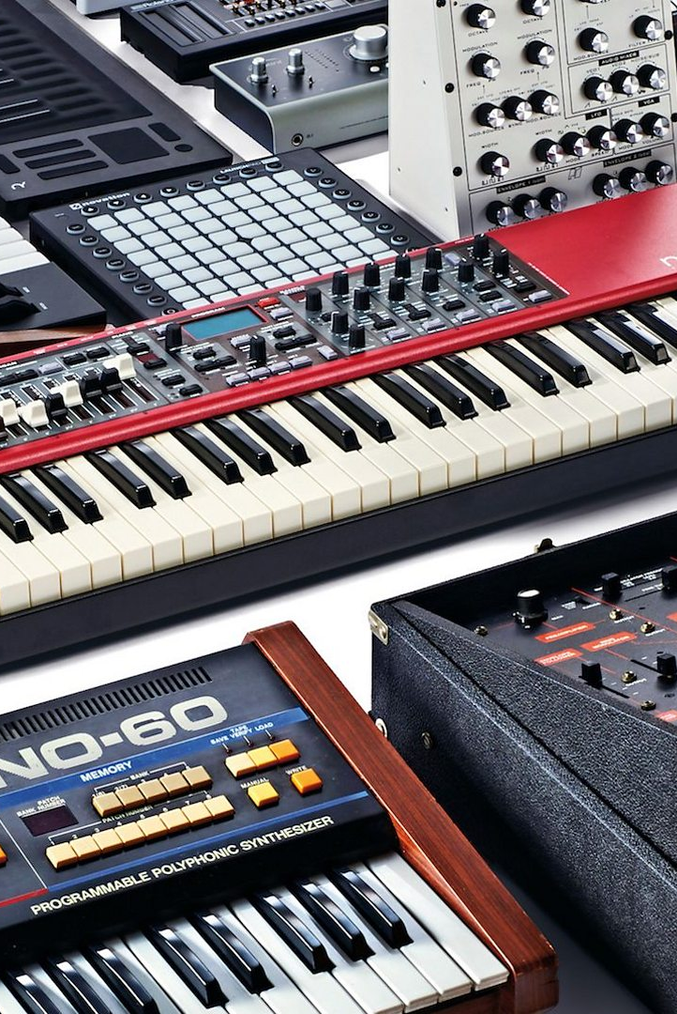
Concept
Build a synthesizer that users can use to create music.
Take computer hardware and interfaces that normal people have and turn into a musical instrument that people can use to express themselves.
Model off traditional synthesizers to provide the same capabilities.
Allow users to customize the sounds like traditional synthesizers.
Synthesizer will also support a vocoder to allow more expression.

Slide 3
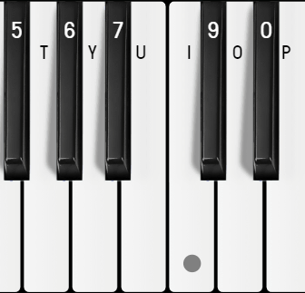
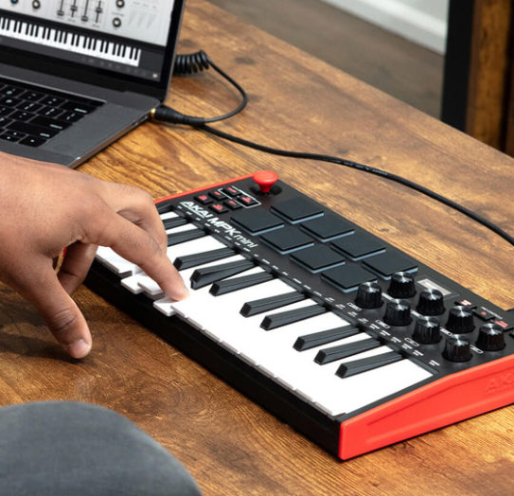
Concept - Interfaces
Computer Keyboard
Using the normal computer keyboard to interface the synth like a normal piano-style key setup.
One row of keys, qwerty, is assigned to white keys and the row above is assigned to black keys.
Users then press the assigned computer key to produce that notes waveform like a traditional synths pressing the white key.
MIDI Keyboard
System will support the use of MIDI keyboards to interface with.
Instead of the computer keyboard to play notes, they will use the actual keyboard.
MIDI keyboards also have knobs, slider, and buttons that can change sound that will affect the synth to provide additional ways to manipulate the sound.
GUI
Provide some interfaces that keyboards cannot accomplish to have the same customization as normal synths.

Slide 4
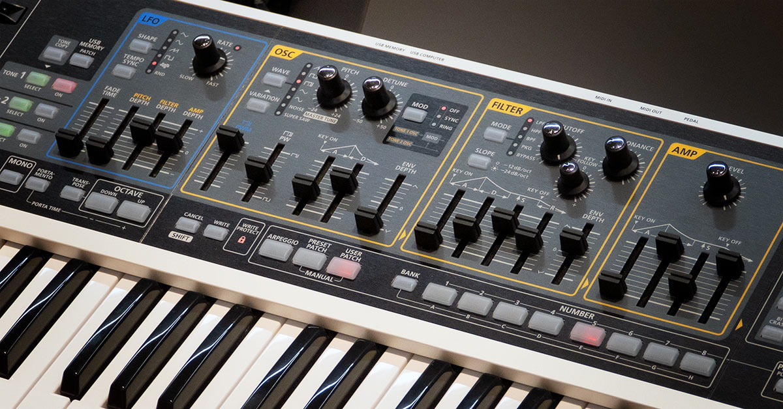
Concept - Data
Synthesizer Core Components
Oscillator
Produces the sound wave from input interfaces
Amplifier
How much of the signal is passed through.
Filter
Removes certain frequencies of the signal.
Envelope
How the signal changes over time.
Gate/Triggers
How notes start and end.
Output
The output would be the synthesized sound from the manipulation of the components and the input of the user.
The output would be sent to the user’s speaker output device for them to listen to and to an output device.
This output device would allow users to record isolated sound of the synth.

Slide 5
Technologies
Visual Programming Language – Pure Data
Max MSP could have better support for this application, but it is closed sourced.
Pure Data is open-sourced and could provide a bigger user group.
Might use additional libraries like Gem and Cyclone to provide for GUI interfaces or to easy development.
Hardware
Basic computer keyboard that most users use to interface with computers
MIDI-compatible keyboard to provide MIDI support.
Allows another way to interface with the application

Slide 6
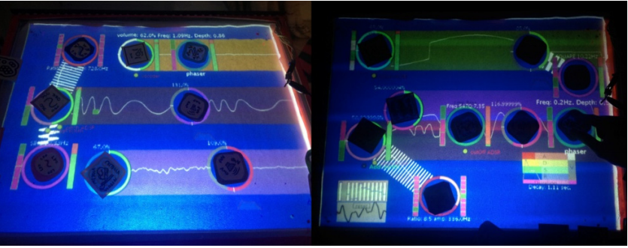
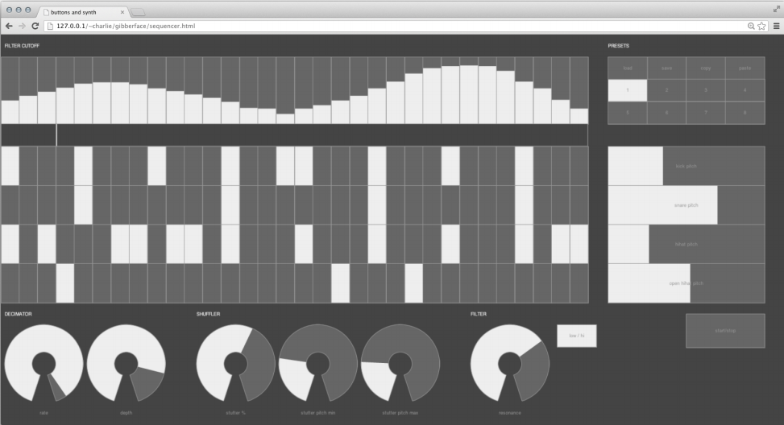
Background
Examples Systems
Midi.city: https://midi.city/
An Online Midi synthesizer that allows you use a synth on the internet with a large library of sounds.
Online Pianist: https://www.onlinepianist.com/virtual-piano
An online Piano that allows to play on the internet.
Academic Example Systems
Roberts’, Wakefield’s, and Wright’s Web Brower Synthesizer.
Using Javascript libraries and APIs, they were able to create a synth in a web browser in a traditional programming language.
Potidis’ and Spyrou’s Spyractable.
A TUI synthesizer like the Reactable. Using a MIDI keyboard and tokens on the TUI, they were able to synthesize sound using a TUI.
Ottosen’s and Dörfler’s Gabor Frames Vocoder
A vocoder using the Gabor Frames Transform to provide better time-stretching than traditional Fouier Transforms.

Slide 7
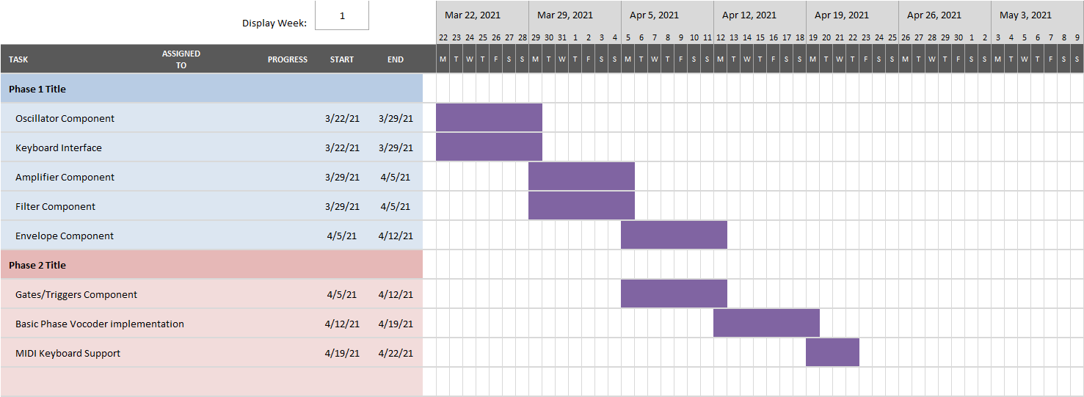
Outline

Slide 8
Questions?

